Slide 1
Engineering Dashboard User Guide
System access and usage
Prepared by: Mok Zhi Zhuan

Slide 2
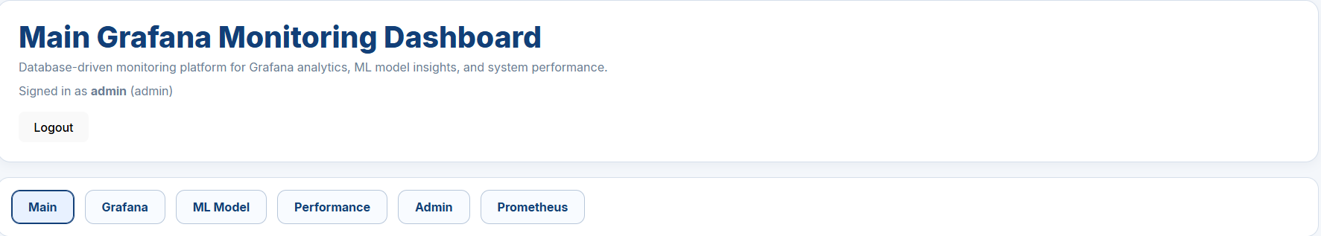
Package Contents
The delivery package includes:
README.md
dashboard-images.tar
docker-compose.yml

Slide 3
Before You Start
Before using the system, please make sure:
Docker Desktop is installed
Docker Desktop is running
A web browser is available
All provided files are kept in the same folder

Slide 4
Load the Docker Images
To load the prepared dashboard images:
Open Command Prompt or PowerShell
Go to the project folder
Run: docker load -i dashboard-images.tar

Slide 5
Start the Dashboard System
After loading the images, start the system by using:
command : docker compose up -d

Slide 6
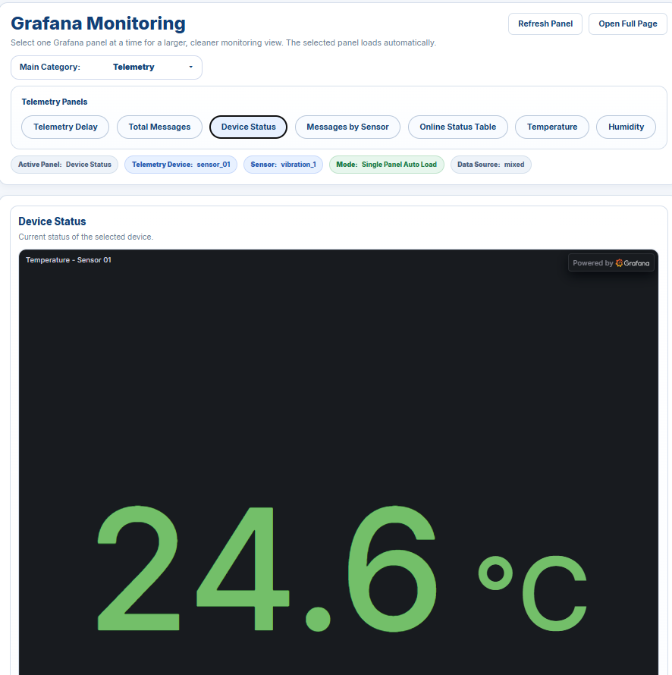
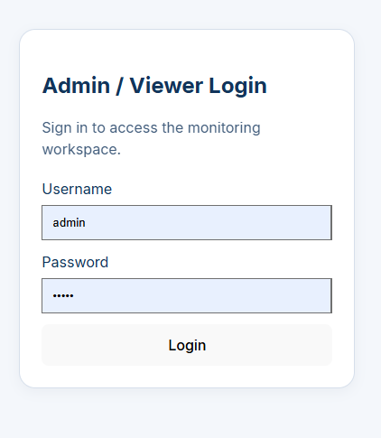
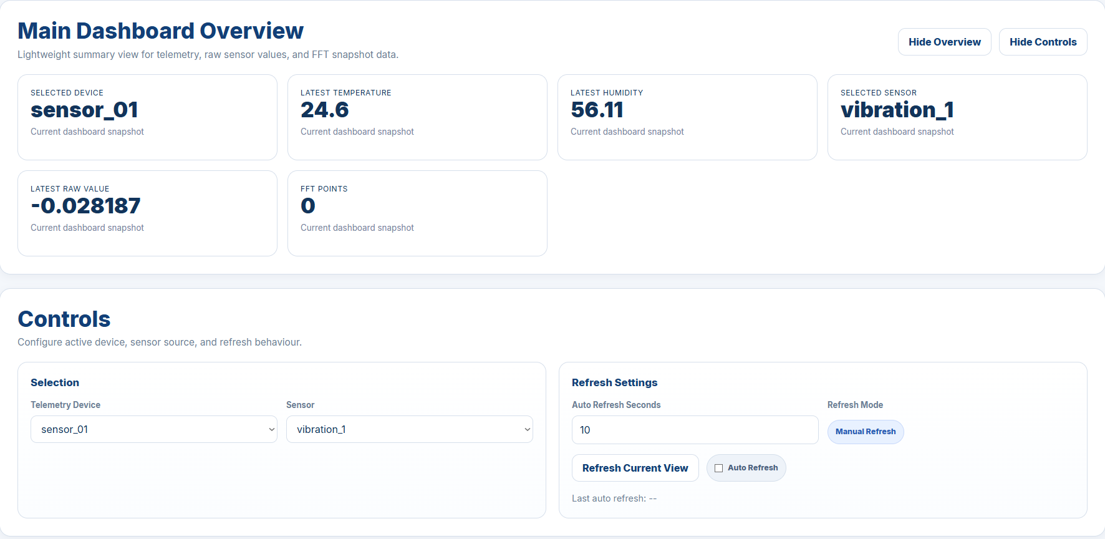
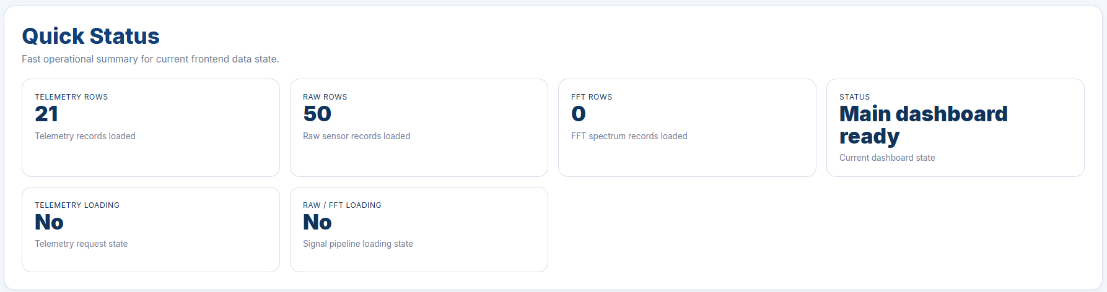
Main System Access Links
Use the following links after the system starts:
Frontend Dashboard: http://localhost:5173
Backend API: http://localhost:8000
Grafana: http://localhost:4000
Prometheus: http://localhost:9090

Slide 7
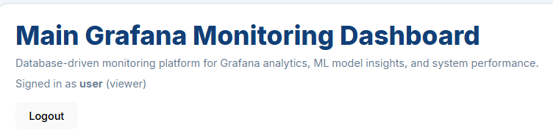
User Login
Use the User account for normal viewing access.
Account details:
Username: user
Password: user
User access includes:
Dashboard viewing
Monitoring pages
General system information

Slide 8
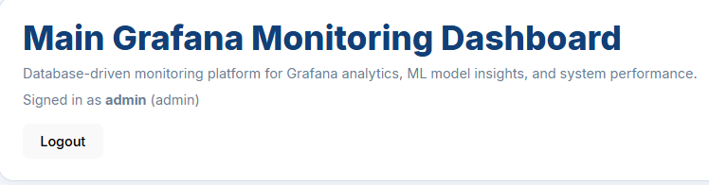
Admin Login
Use the Admin account for management access.
Account details:
Username: admin
Password: admin
Admin access includes:
Admin controls
Simulator controls
System management features

Slide 9
User and Admin Access Overview
Access Type | What It Can Do
User | View dashboard pages and monitoring information
Admin | Access admin features , simulator controls , and management tools

Slide 10
Summary
Load the Docker images first
1
Start the dashboard services
2
Open the system using the provided links
3
Use the correct login account for access
4
Keep the provided files for future setup and reference
5

